Slide 1
Employee Management
Team Name- Code#
Members-
Lokesh Pamnani
Saksham Kumar
Mahima Soni
Siddhant Sharma
Sumit Mandoliya

Slide 2
1. Predicting Employee Attendance
The attendance is taken through biometrics.
The overtime hours done by each employee will be calculated through the timestamps collected in the database.
A data set will be created for each employee for every month.
This dataset will be used as a trainer set for the predicting model.
For each employee according to the model the concerned person will be able to see whether the employee is regular or not and if he/she will come on a particular day.
Further this database will also be used to calculate the total working hours and efficiency of the employee.

Slide 3
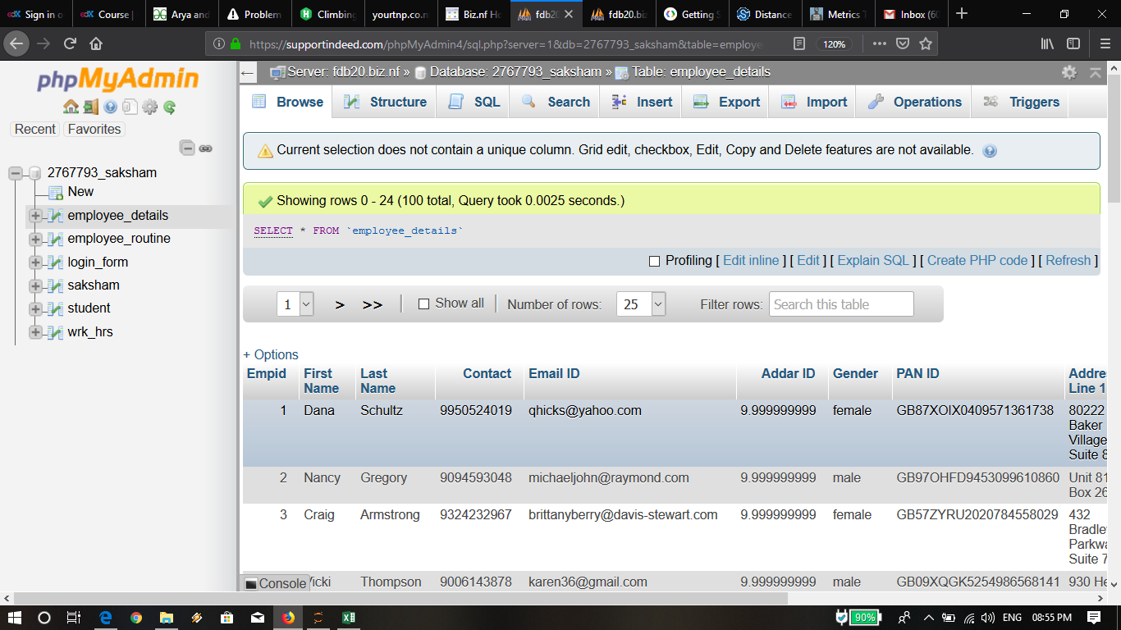

Slide 4
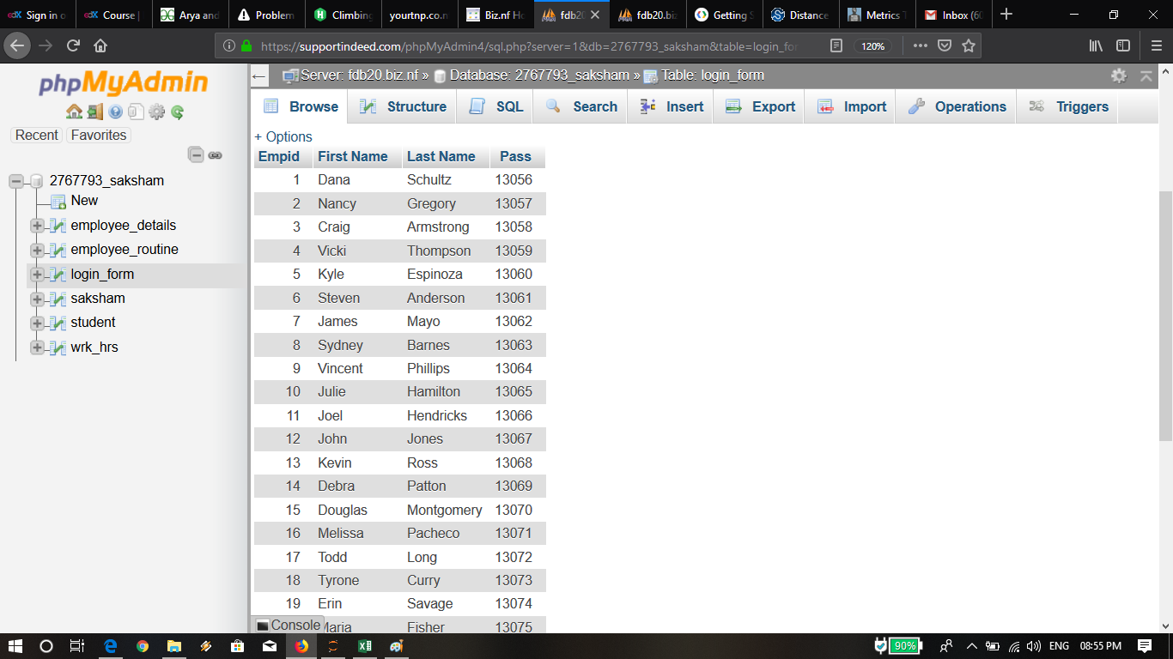

Slide 5
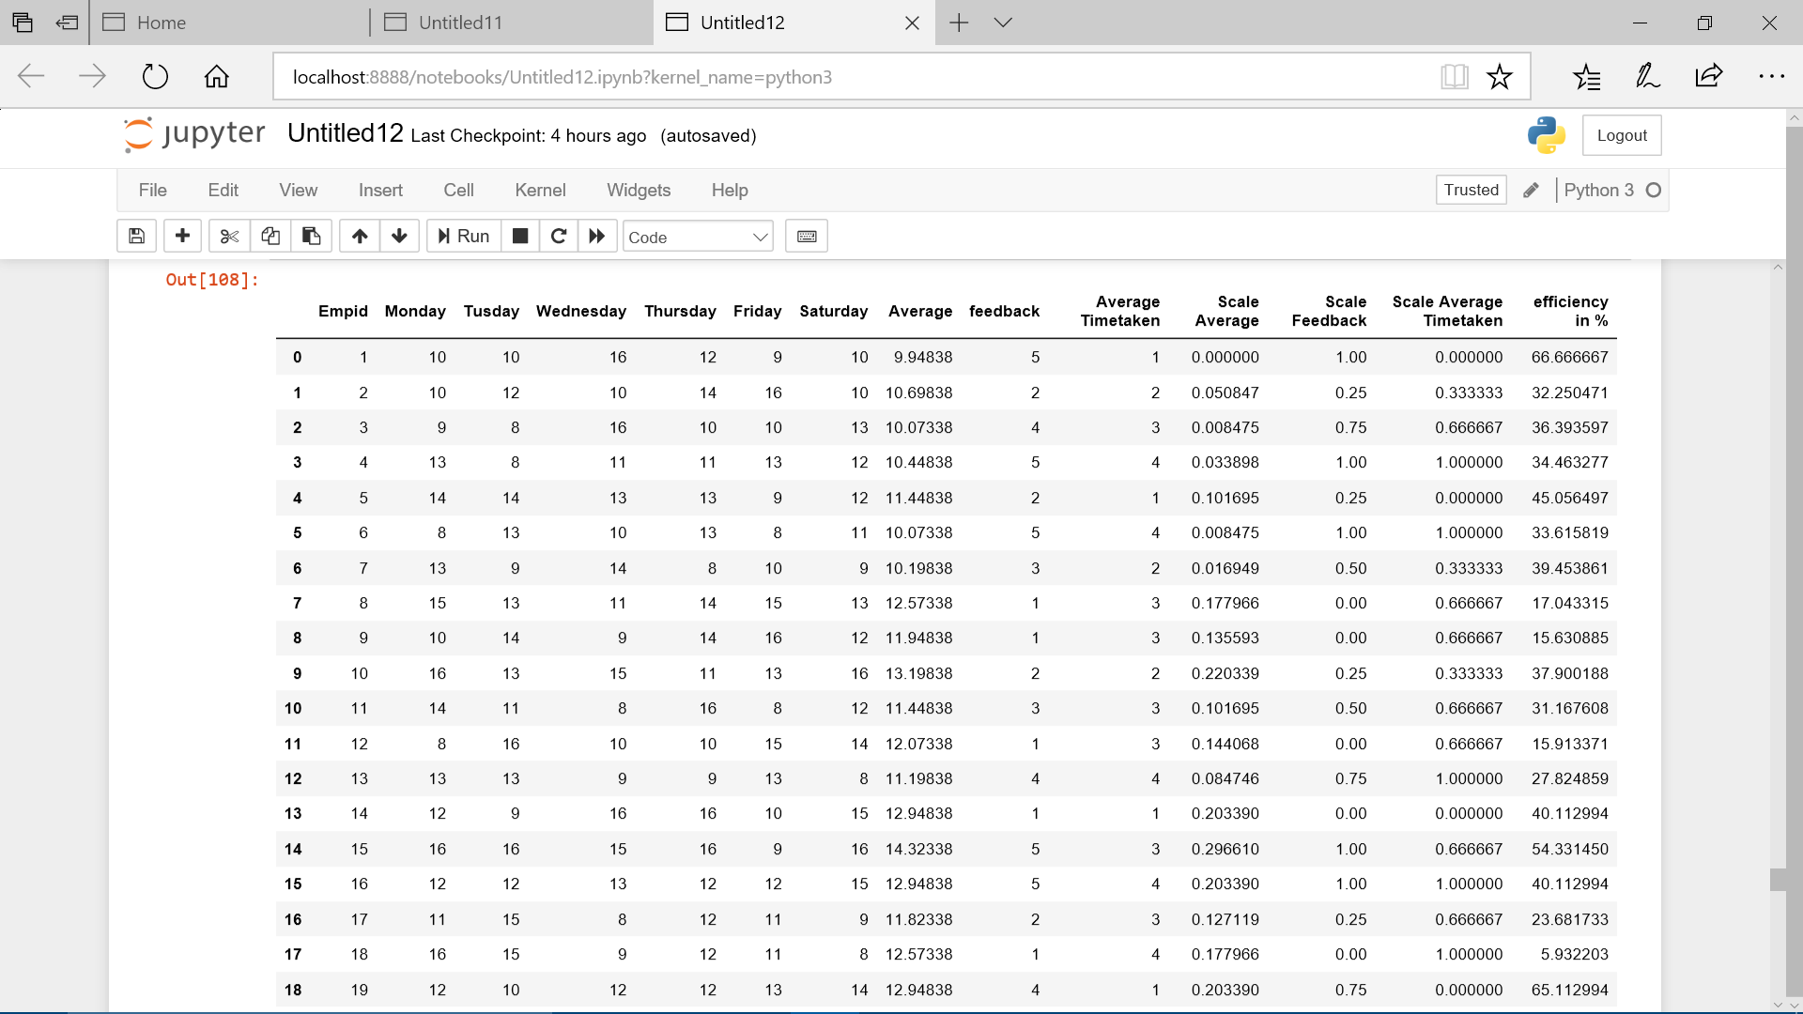

Slide 6
2. Call Allocation
A database having Number of tasks completed by employee per week, working hours per week, efficiency of person and feedback rating is maintained.
Efficiency is calculated by Number of tasks completed and the total hours taken.
Every week the data is updated and new efficiency of employee is calculated .Based on the efficiency we can predict the number of call that should be allocated to the employee.

Slide 7
Employee’s Efficiency Prediction To allocate future calls.
Based on these parameters:-Average working hours per week, feedback of the customer , Average time to complete a task ,the efficiency of the employee is calculated and then we prepared a Machine learning Model using Random Forest Regression in Python.
The model is trained on the real time database and then the efficiency is predicted accordingly .
Then the outliers are identified by Boxplot between Efficiency in % and Average timetaken.

Slide 8
We are using GoogleMaps API to get the best route between the company and the problem area.
The duration and distances are calculated and updated in the database.
According to this info the best routes are found for completing maximum tasks.
We get the strongly connected components of the graph , so this gives optimal route.

Slide 9
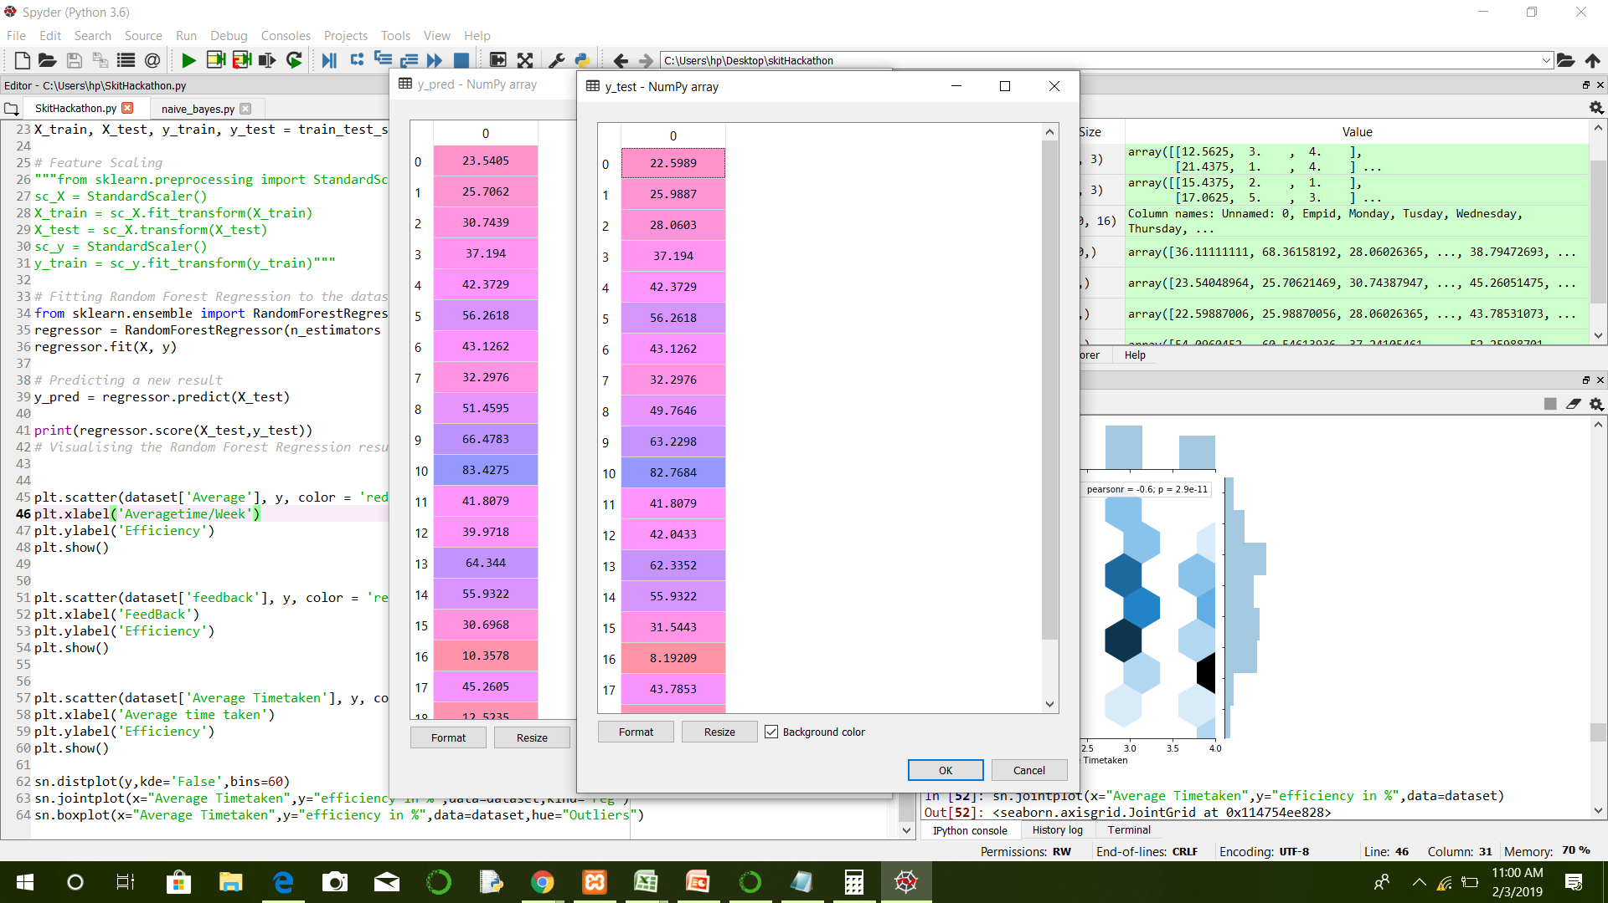

Slide 10
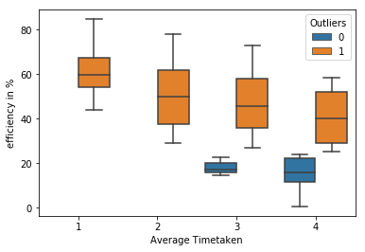

Slide 11
